Slide 1

OBJECT CLASSIFICATION IN MULTIPLE LANGUAGES
Project By:-
Anshuman Sekhar Dash
Pruthiraj Marndi
Swagat Kumar Dora
Sanjay Tudu
Guided By:-
D. K. Swain
Asst. Professor
CSEA Dept.
IGIT Sarang

Slide 2
Contents
Introduction
Product Idea
Flow Diagram
Steps in Development
DataSet Collection and Gathering
Training of Convolutional Neural Network
ImageNet Models Performance
Android Application Development
Language Specific Changes
Conclusion
References

Slide 3
Introduction
This Project is based on Existing Object Detection and Classification Techniques present but Instead of Classifying the Objects into any particular Language (for e.g. English) the Android Application Developed during this project work can classify in more than one Speaking Language i.e.English,Odia,Hindi etc. The product specified belongs to the class of object detection applications but unlike other applications emphasis was put on classifying objects according to the user’s language choice in order to get more specific results.

Slide 4
Product Idea
Many a times we encounter a different tangible item or object and we have no idea what it’s called. Existing object classification apps only shows us what the item is in English and not in any other local languages.
This project is to help users overcome this problem with just the use of a Smartphone.

Slide 5
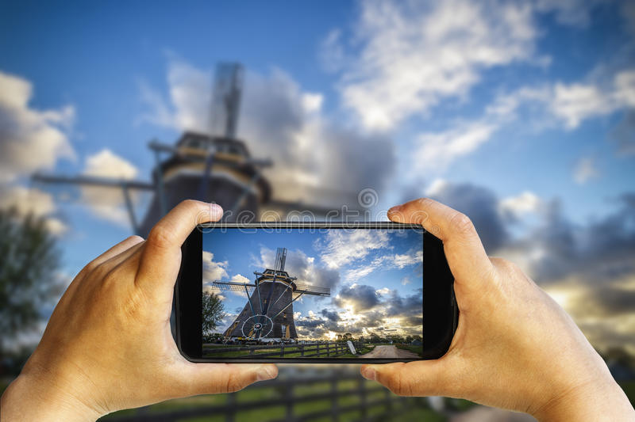

Slide 6
Flow Diagram
User opens the App
User Selects the language on which he/she wants the classification
Captures the image of the object .
The Image is Resized
The image is fed on the tensor flow object detection model present in the app
The output is shown on the screen
User Reports Errors
By uploading the image using the correct Label

Slide 7
Steps in Development
Dataset Collection and Gathering
Training of Convolutional Neural Network using transfer Learning
Application Developement
Translation of Labels

Slide 8
Dataset Collection and Gathering
For training to work well, at least a hundred photos of each kind of object which is to be recognized needs to be gathered
The more photos gathered, the better the accuracy of the trained model is likely to be. It is needed to make sure that the photos are a good representation of what the application will actually encounter
For example, if all photos are indoors against a blank wall and the users are trying to recognize objects outdoors, we won't see good results when deployed.

Slide 9
Dataset Collection and Gathering
At least 20 images of each Categories were downloaded which were distinct and contains only the specified Object image for Proper training.
The Similar images were grouped into folder, The folder names are used as Label Names.
The images were downloaded from
various non-copyrighted and open source images such as Google’s Image Net.
from Kaggle.com the dataset named “Natural Images” by Prasun Roy.

Slide 10
Training of Convolutional Neural Network
Modern image recognition models have millions of parameters. Training them from scratch requires a lot of labelled training data and a lot of computing power (hundreds of GPU-hours or more). Transfer learning is a technique that shortcuts much of this by taking a piece of a model that has already been trained on a related task and reusing it in a new model. In this Project we will reuse the feature extraction capabilities from powerful image classifiers trained on Image Net and simply train a new classification layer on top.

Slide 11
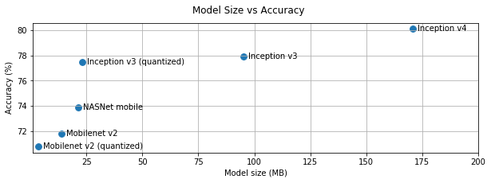
ImageNet Models Performance
Model Size vs Accuracy

Slide 12
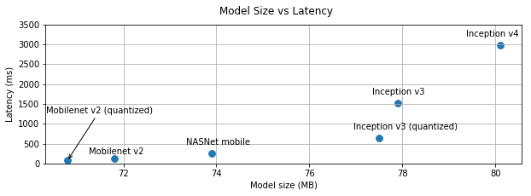
ImageNet Models Performance
Model Size vs Latency

Slide 13
After careful consideration and using the above facts and analysis we select mobilenet_0.50_224 model for the purpose of transfer learning.

Slide 14
python -m scripts.retrain
--bottleneck_dir=tf_files/bottlenecks
--how_many_training_steps=500
--model_dir=tf_files/models/
--summaries_dir=tf_files/training_summaries/"${ARCHITECTURE}"
--output_graph=tf_files/retrained_graph.pb
--output_labels=tf_files/retrained_labels.txt
--architecture="${ARCHITECTURE}"
--image_dir=tf_files/photos

Slide 15
The Retrain script loads the pre-trained module and trains a new classifier on top for the photos we've downloaded. The magic of transfer learning is that lower layers that have been trained to distinguish between some objects can be reused for many recognition tasks without any alteration. The first phase analyzes all the images on disk and calculates and caches the bottleneck values for each of them. These ImageNet models are made up of many layers stacked on top of each other, These layers are pre-trained and are already very valuable at finding and summarizing information that will help classify most images. Once the bottlenecks are complete, the actual training of the top layer of the network begins.

Slide 16
Android Application Development
Mobile devices have significant limitations, so any pre-processing that can be done to reduce an app's footprint is worth considering.
Inference efficiency is a critical issue when deploying machine learning models to mobile devices because of the model size, latency, and power consumption.
Computational demand for training grows with the number of models trained on different architectures, whereas the computational demand for inference grows in proportion to the number of users.

Slide 17
We Used TensorflowLite inference Engine which enables on-device machine learning inference with low latency and a small binary size.
These include pruning unused graph-nodes, and performance improvements by joining operations into more efficient composite operations.

Slide 18
String classifyFrame(Bitmap bitmap) { convertBitmapToByteBuffer(bitmap); tflite.run(imgData, labelProbArray);
//K is initialized as 1 since we only require //the top result.
String textToShow = printTopKLabels();
}

Slide 19
This method does three things.
First converts and copies the input Bitmap to the imgData ByteBuffer for input to the model.
Then it calls the interpreter's run method, passing the input buffer and the output array as arguments.
The interpreter sets the values in the output array to the probability calculated for each class.

Slide 20
Language Specific Changes The lables.txt file generated after retraining is as shown below
Pomegranate
Backpack
Bellpepper
Board
Broccoli
Corn
Daisy
Dandelion
Deskflower
Vase
Guava
Keys
Mango
Marigold
Mobilephones
Onion
Papaya
Pen
Pineapple
Podium
Potato
Pumpkin
Purse
Roses
Spectacles
Sunflowers
Tulips
wallet

Slide 21
The above labels are stored as a string array in strings.xml file which is different for different Locales
This array is the extracted as Arraylist. The classifyframe function then prints Out labels according to position of the array.
The original labels are used as the key and the specific language word is inside the value

Slide 22
Since for faster processing and less size a smaller model is used, The accuracy is hampered and the Classification may not be correct.
For Correction and Retraining of the model a feedback option is provided.
This feedback option takes a snapshot of the object and asks for a label name from the user.
The user can enter the name in any of the languages available.
This image along with the text entered is uploaded to firebase realtime database for storage and analysis.

Slide 23
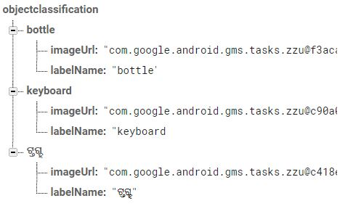
Database Tree Structure

Slide 24
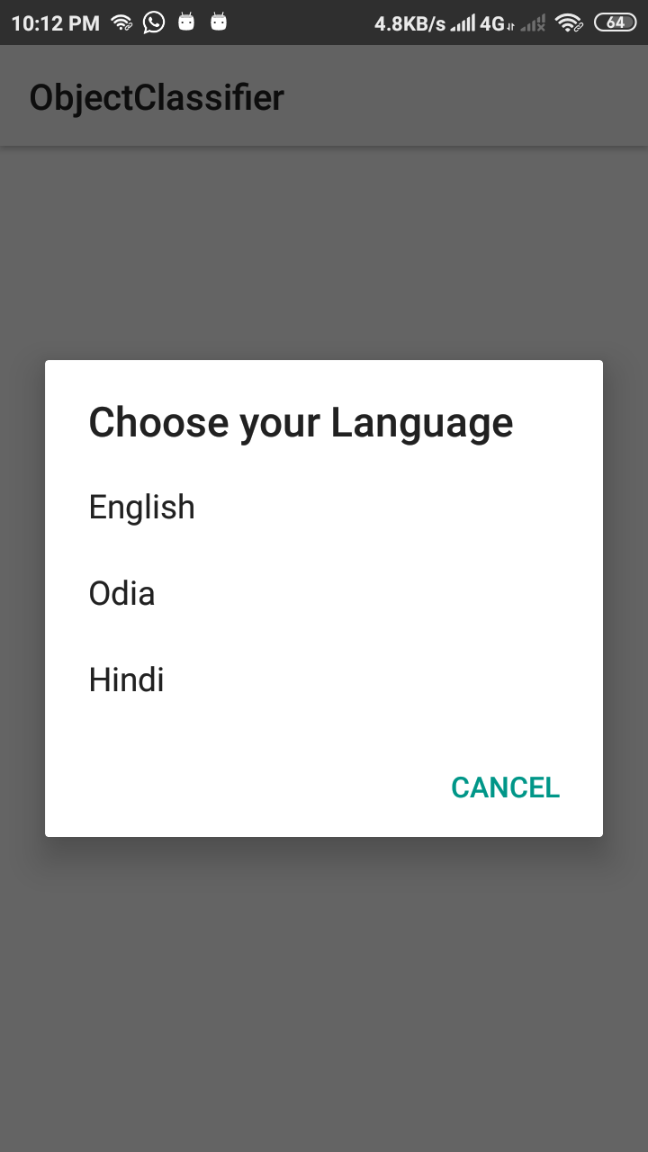

Slide 25
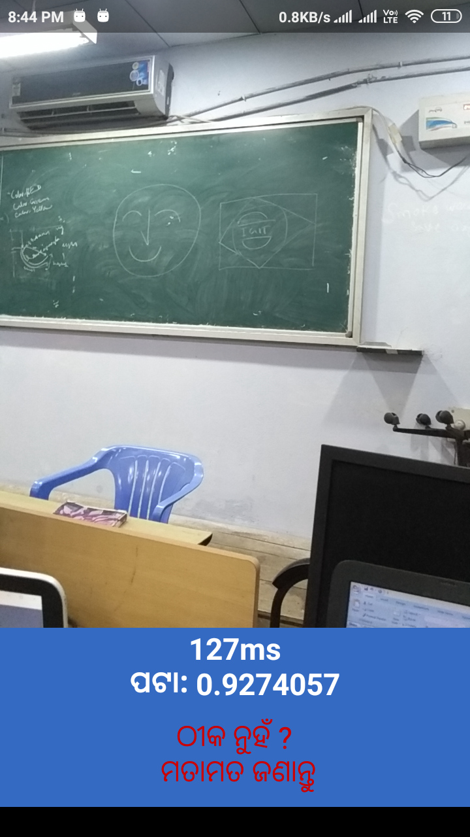

Slide 26
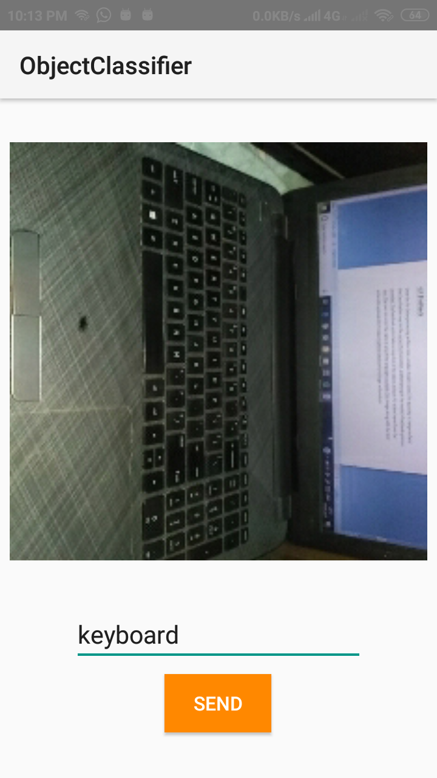

Slide 27
Conclusion
Through this project we explored the field of computer vision and machine learning.
This Application is an attempt at developing an object detection, classification and language translation system using modern computer vision technology and artificial intelligence.
We used mobilenets image classification model for retraining with more more than 30 categories of objects.
We have at present provided translation for only 3 languages namely English,odia and Hindi.

Slide 28
The further steps towards the development of the application will include:-
Adding more languages
Adding more classes of objects
Word pronunciation feature for each language.
The application is uploaded on the Google Play store for use by the General People. The link to which is
https://play.google.com/store/apps/details?id=com.anshumansekhar.objectclassification

Slide 29
References
MobileNets: Efficient Convolutional Neural Networks for Mobile Vision Applications by Andrew G. Howard, Menglong Zhu
Research on Computer Vision-Based Object Detection and Classification by-Juan Wu, Bo Peng , Zhenxiang Huang , Jietao Xie
Computer Vision Technology for Food Quality Evaluation by-Chengjin Du. Du, Hongju HeDa-Wen Sun
Transfer Learning by Lisa Torrey and Jude Shavlik
S. Singh. Transfer of learning by composing solutions of elemental sequential tasks. Machine Learning
ImageNet Classification with Deep Convultional Neural Networks by Alex Krizhevsky,Ilya Sutskever,Geofferey E Hinto

Slide 30
Thank You

